Slide 1
Welcome to LGIS
Logging in to LGIS

Slide 2
Go to https://www.localgovernmentinformationsystem.gov.bc.ca/EXT/default.aspx
Enter your Business BCeID username and password, click Continue (every user must have their own login username and password).

Slide 3
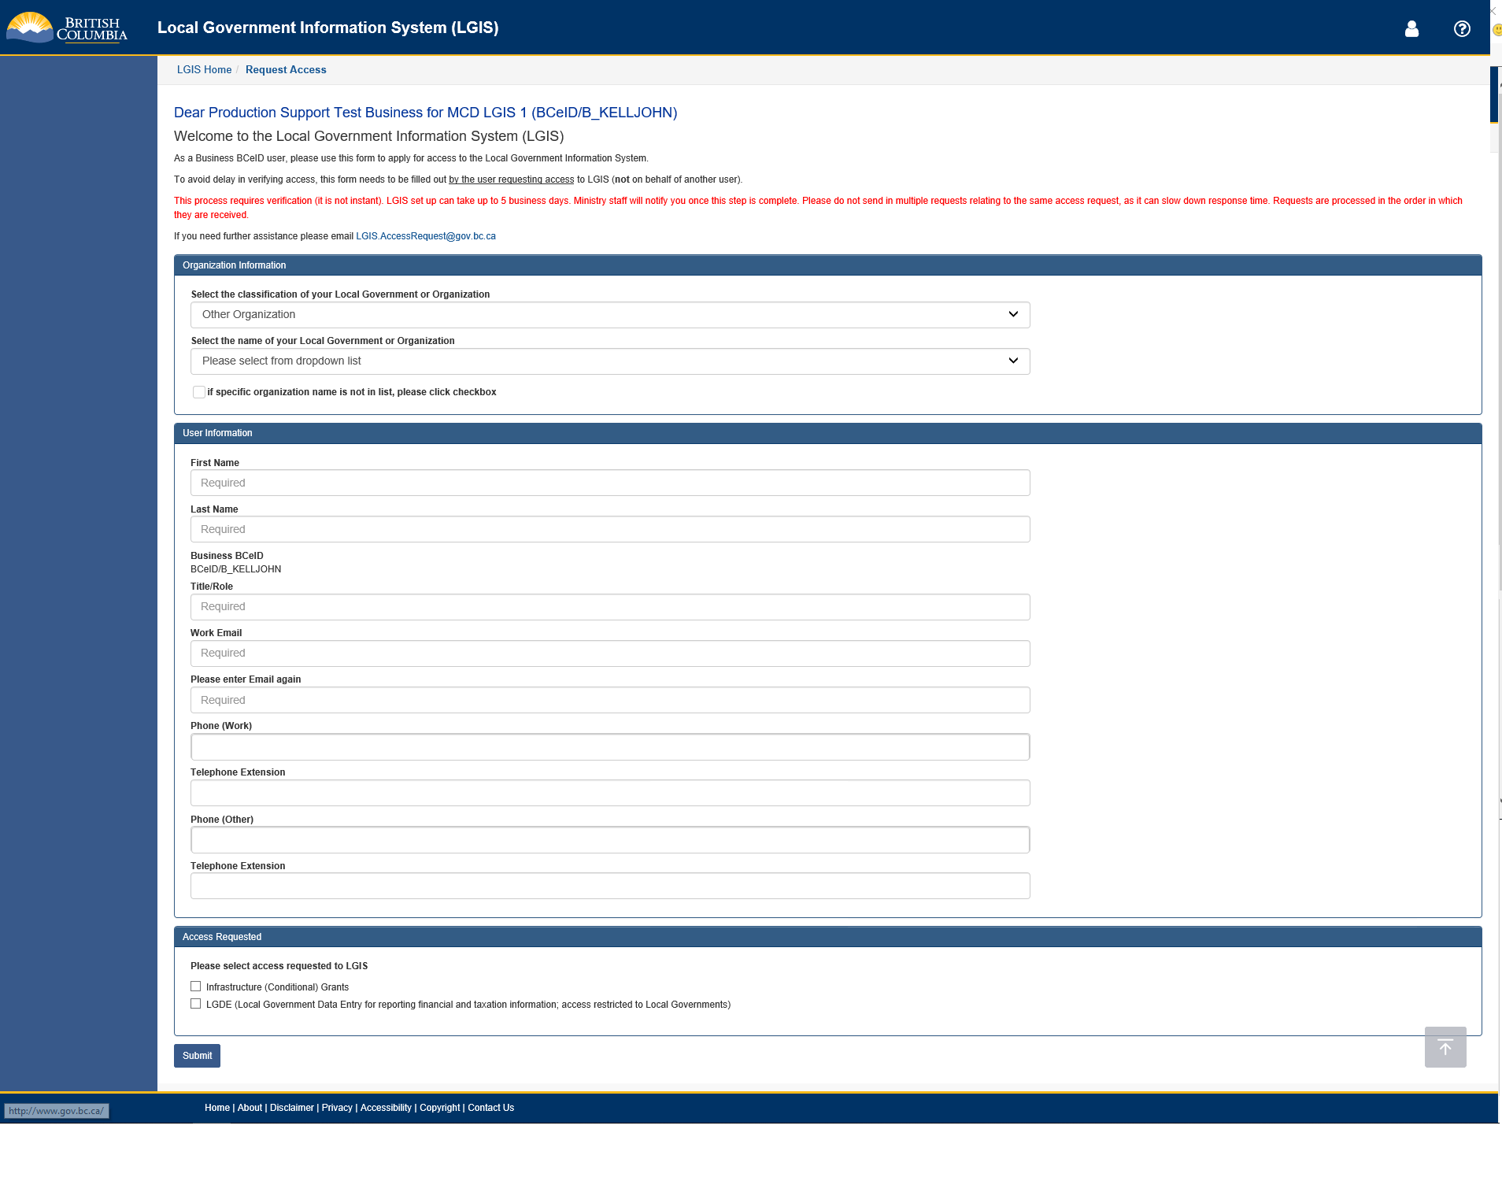
If your Business BCeID account has not been linked to an organization in LGIS, after logging in you will see the Request Access Screen.

Slide 4
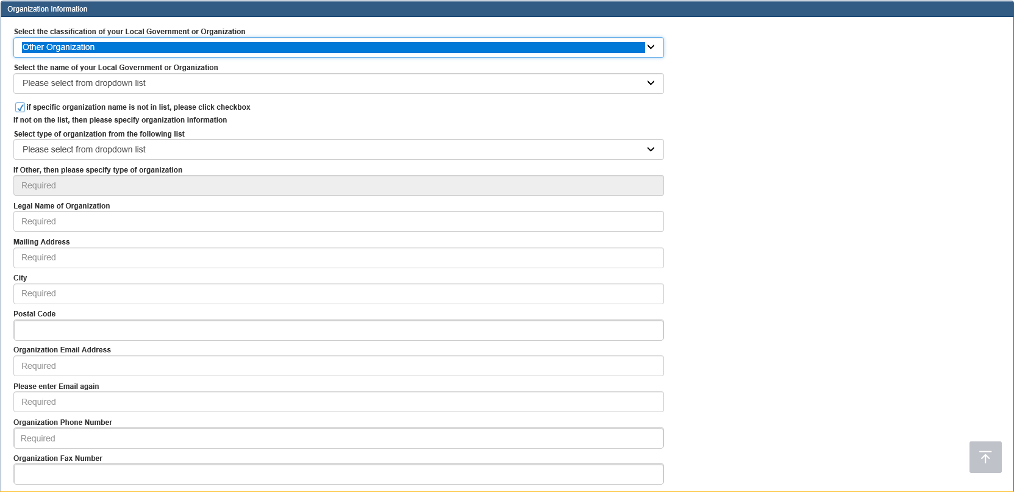
Select the type of your organization (Local Government or Other Organization) in the first dropdown box, then search for your Local Government or organization name in the new dropdown list. If your organization is not in the list, check the box for ‘If specific organization name is not in the list.
If your organization was not in the list, select the type of organization (ex: First Nation) and populate all fields marked “Required”.

Slide 5
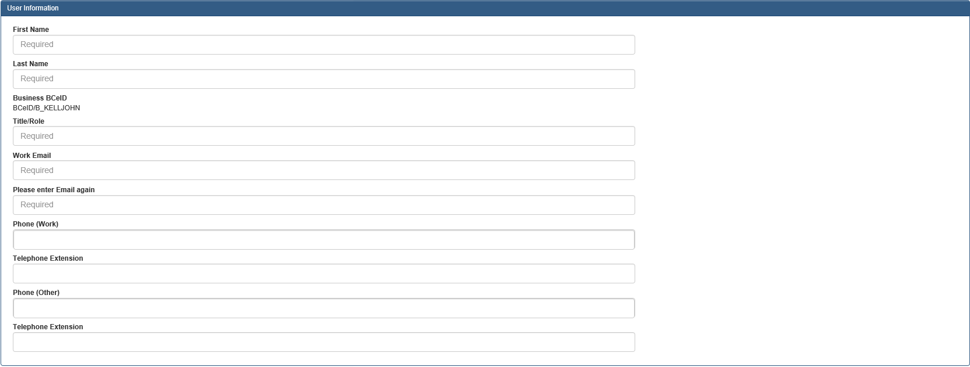
After selecting or entering details for the organization, complete the User Information Section.

Slide 6
If your BCeID is not linked to an Organization in LGIS please complete the Access Requested section.
Check the box for Infrastructure (Conditional) Grants if you require access to apply for, submit reporting for (Budget Forecast/Periodic Progress Report), or submit claims for Infrastructure Grants.
Check the box for LGDE (Local Government Data Entry for reporting financial and taxation information; access restricted to Local Governments) if you need access to submit reporting for Local Government financial and taxation information.
Once the form has been completed, Click the Submit Button.
This process requires verification (it is not instant). LGIS set up can take up to 5 business days. Ministry staff will notify you once this step is complete.

Slide 7
If your BCeID account is linked to an organization in LGIS, you will be directed to your history of logging into LGIS. Click Next. The Welcome page now displays general information regarding LGIS as well as important Ministry Contact information.
The blue navigation bar on the left side of the screen displays all of the pages that your BCeID allows you access to.

Slide 8
LGIS Website :
https://www.localgovernmentinformationsystem.gov.bc.ca/
For access and technical assistance please contact: Phone: (250) 953-3008 Email : LGIS.AccessRequest@gov.bc.ca
For program and claim assistance please contact: Phone: (250) 387-4060 Email : infra@gov.bc.ca

